Slide 1
Probabilistic Machine Learning Probability Basics (Contd)
CSN-382

Slide 2

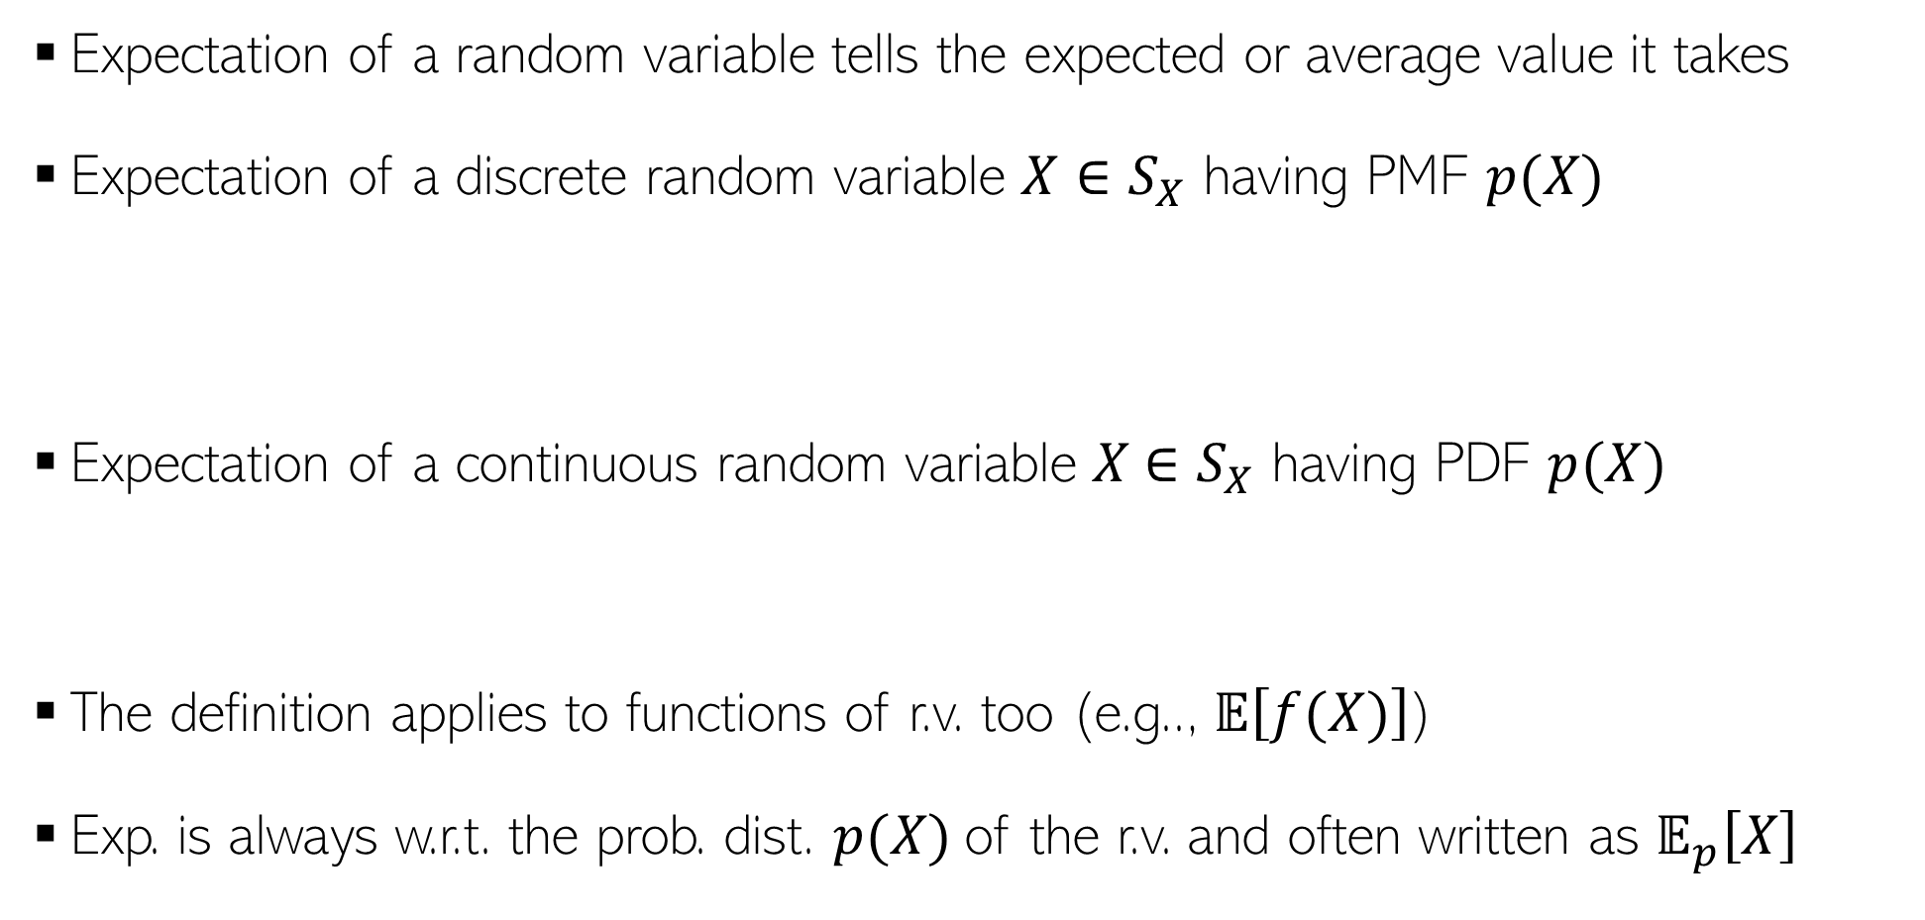

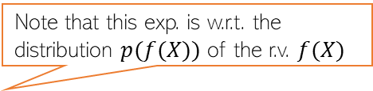
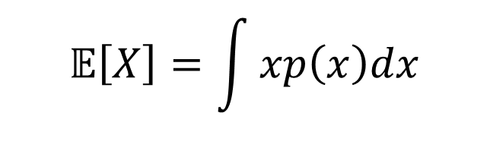
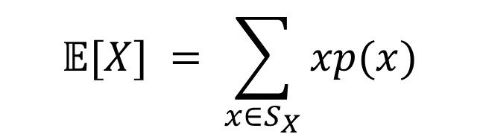

Expectation
Expectation of a random variable tells the expected or average value it takes
Expectation of a discrete random variable $X∈S_{X}$ having PMF $p(X)$
Expectation of a continuous random variable $X$ $∈S_{X}$ having PDF $p(X)$
The definition applies to functions of r.v. too (e.g.., $𝔼\left[f(X)\right]$)
Exp. is always w.r.t. the prob. dist. $p(X)$of the r.v. and often written as $𝔼_{p}\left[X\right]$
$$𝔼[X] = \sum_{x∈S_{X}}{xp(x)}$$
Probability that $X = x$
$$𝔼\left[X\right]=\int{xp\left(x\right)dx}$$
Probability density at $X = x$
Note that this exp. is w.r.t. the distribution $p(f(X))$ of the r.v. $f(X)$
$$x∈S_{X}$$
Often the subscript is omitted but do keep in mind the underlying distribution

Slide 3
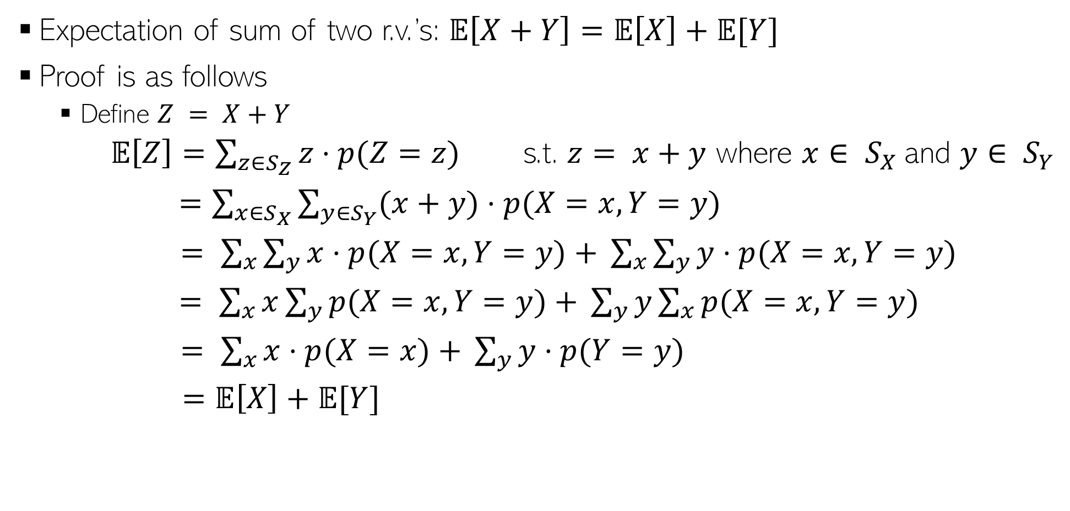
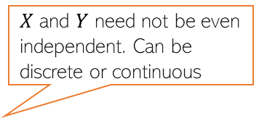
Expectation: A Few Rules
$X$ and $Y$ need not be even independent. Can be discrete or continuous
Expectation of sum of two r.v.’s: $𝔼\left[X+Y\right]=𝔼\left[X\right]+𝔼[Y]$
Proof is as follows
Define $Z = X+Y$
$𝔼\left[Z\right]=\sum_{z∈S_{Z}}{z⋅p(Z=z)}$ s.t. $z= x+y$ where $x∈ S_{X}$and $y∈ S_{Y}$
$=\sum_{x∈S_{X}}{\sum_{y∈S_{Y}}{(x+y)⋅p(X=x,Y=y)}}$
$= \sum_{x}{\sum_{y}{x⋅p(X=x,Y=y)}}$ $+ \sum_{x}{\sum_{y}{y⋅p(X=x,Y=y)}}$
$= \sum_{x}{x\sum_{y}{p(X=x,Y=y)}}$ $+ \sum_{y}{y\sum_{x}{p(X=x,Y=y)}}$
$= \sum_{x}{x⋅p(X=x)}$ $+ \sum_{y}{y⋅p(Y=y)}$
$=𝔼\left[X\right]+𝔼[Y]$
Used the rule of marginalization of joint dist. of two r.v.’s

Slide 4

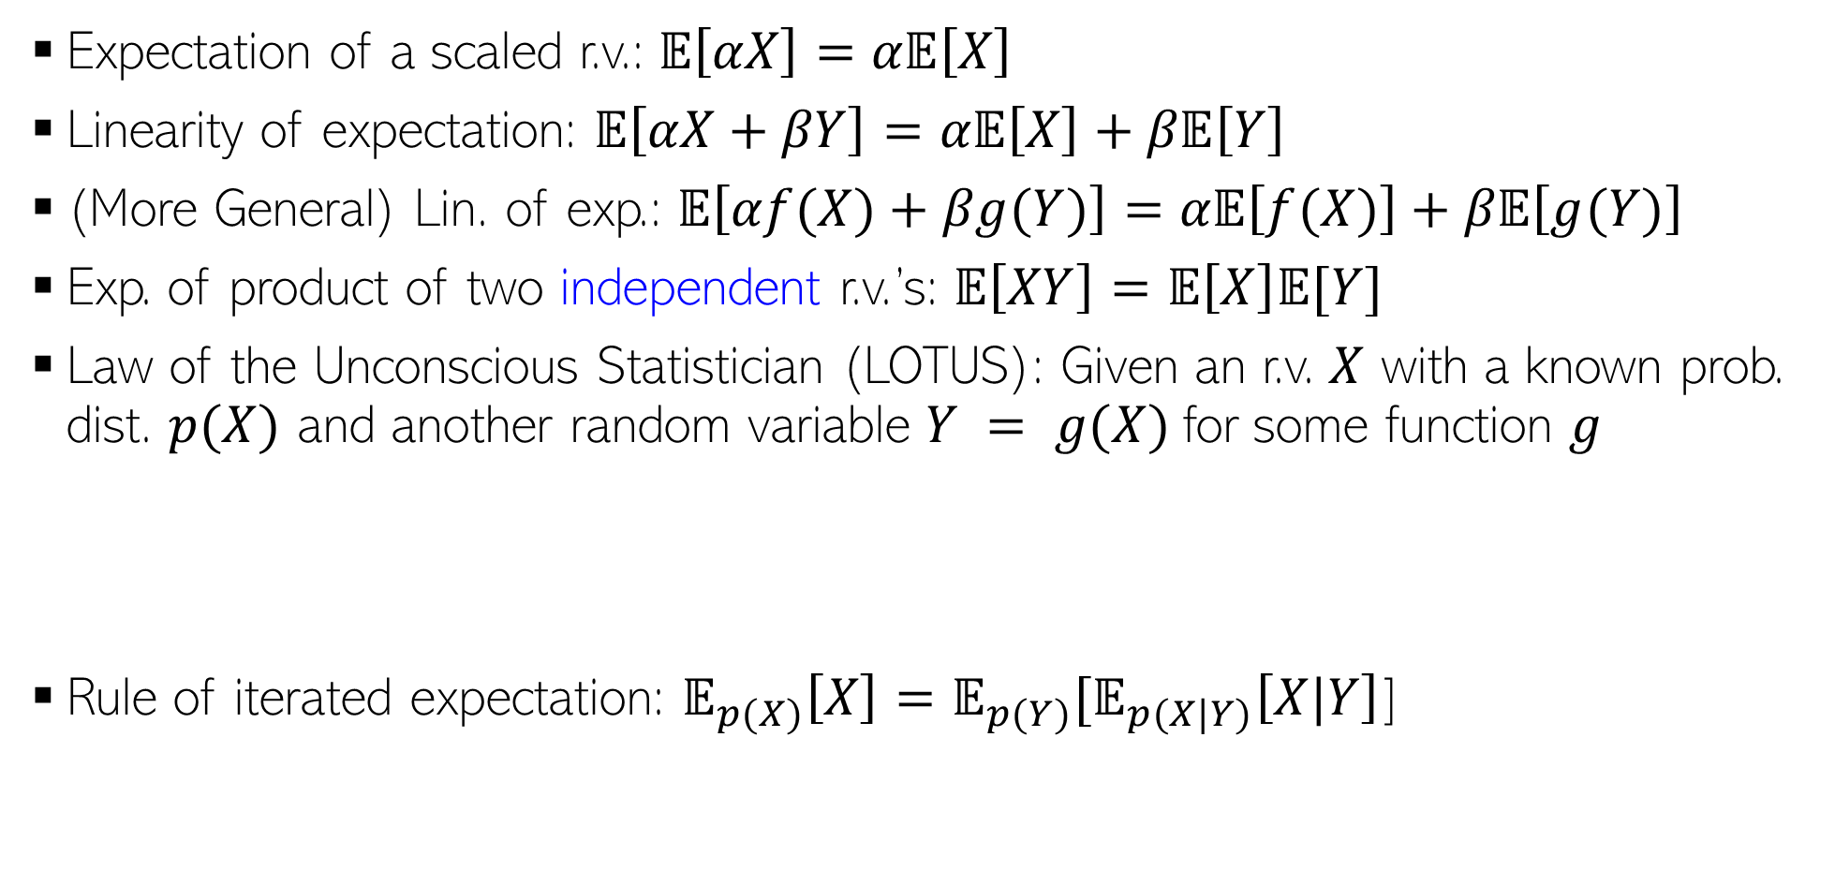

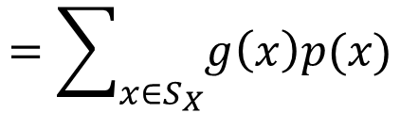
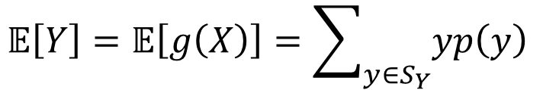



Expectation: A Few Rules (Contd)
$α$is a real-valued scalar
$α$and $β$are real-valued scalars
Expectation of a scaled r.v.: $𝔼\left[αX\right]=α𝔼\left[X\right]$
Linearity of expectation: $𝔼\left[αX+βY\right]=α𝔼\left[X\right]+β𝔼\left[Y\right]$
(More General) Lin. of exp.: $𝔼\left[αf(X)+βg(Y)\right]=α𝔼\left[f(X)\right]+β𝔼\left[g(Y)\right]$
Exp. of product of two independent r.v.’s: $𝔼\left[XY\right]=𝔼\left[X\right]𝔼[Y]$
Law of the Unconscious Statistician (LOTUS): Given an r.v. $X$ with a known prob. dist. $p(X)$ and another random variable $Y = g(X)$for some function $g$
Rule of iterated expectation: $𝔼_{p(X)}\left[X\right]=𝔼_{p(Y)}[𝔼_{p(X|Y)}\left[X|Y\right]$]
$f$ and $g$ are arbitrary functions.
Requires finding $p(Y)$
Requires only $p(X)$ which we already have
$$𝔼\left[Y\right]=𝔼\left[g\left(X\right)\right]=\sum_{y∈S_{Y}}{yp\left(y\right) }$$
$$=\sum_{x∈S_{X}}{g\left(x\right)p(x)}$$
LOTUS also applicable for continuous r.v.’s

Slide 5
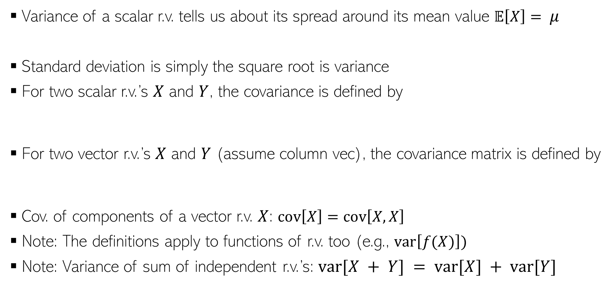
Variance and Covariance
Variance of a scalar r.v. tells us about its spread around its mean value $𝔼\left[X\right]= μ$
Standard deviation is simply the square root is variance
For two scalar r.v.’s $X$ and $Y$, the covariance is defined by
For two vector r.v.’s $X$ and $Y$ (assume column vec), the covariance matrix is defined by
Cov. of components of a vector r.v. $X$: $cov\left[X\right]=cov\left[X,X\right]$
Note: The definitions apply to functions of r.v. too (e.g., $var\left[f(X)\right])$
Note: Variance of sum of independent r.v.’s: $var[X + Y] = var[X] + var[Y]$
$$var\left[X\right]=𝔼\left[{\left(X−μ\right)}^{2}\right]=𝔼\left[X^{2}\right] −μ^{2}$$
$$cov\left[X,Y\right]=𝔼\left[\{X−𝔼[X]\}\{Y−𝔼[Y]\}\right]=𝔼\left[XY\right]−𝔼[X]𝔼[Y]$$
$$cov\left[X,Y\right]=𝔼\left[\{X−𝔼[X]\}\{Y^{⊤}−𝔼[Y^{⊤}]\}\right]=𝔼\left[XY^{⊤}\right]−𝔼[X]𝔼[Y^{⊤}]$$
Important result
Notes:
Covariance = 0 means that variables are linearly independent, but it doesn’t mean that they are independent. If two variables are independent, then covariance will also be = 0.

Slide 6
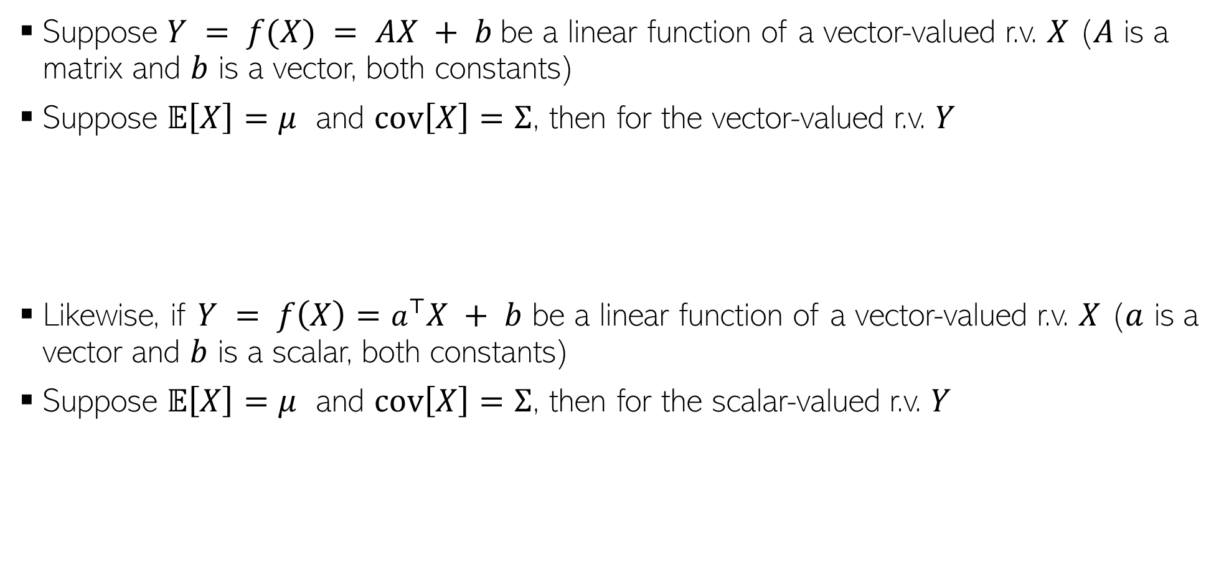
Transformation of Random Variables
Suppose $Y = f(X) = AX + b$be a linear function of a vector-valued r.v. $X$ ($A$ is a matrix and $b$ is a vector, both constants)
Suppose $𝔼\left[X\right]=μ$ and $cov\left[X\right]=Σ$, then for the vector-valued r.v. $Y$
Likewise, if $Y = f\left(X\right)=a^{⊤}X + b$ be a linear function of a vector-valued r.v. $X$ ($a$ is a vector and $b$ is a scalar, both constants)
Suppose $𝔼\left[X\right]=μ$ and $cov\left[X\right]=Σ$, then for the scalar-valued r.v. $Y$
$$𝔼\left[Y\right]=𝔼\left[AX+b\right]=Aμ+b$$
$$cov\left[Y\right]=cov\left[AX+b\right]=AΣA^{⊤}$$
$$𝔼\left[Y\right]=𝔼\left[a^{⊤}X + b\right]=a^{⊤}μ+b$$
$$var\left[Y\right]=var\left[a^{⊤}X + b\right]=a^{⊤}Σa$$

Slide 7
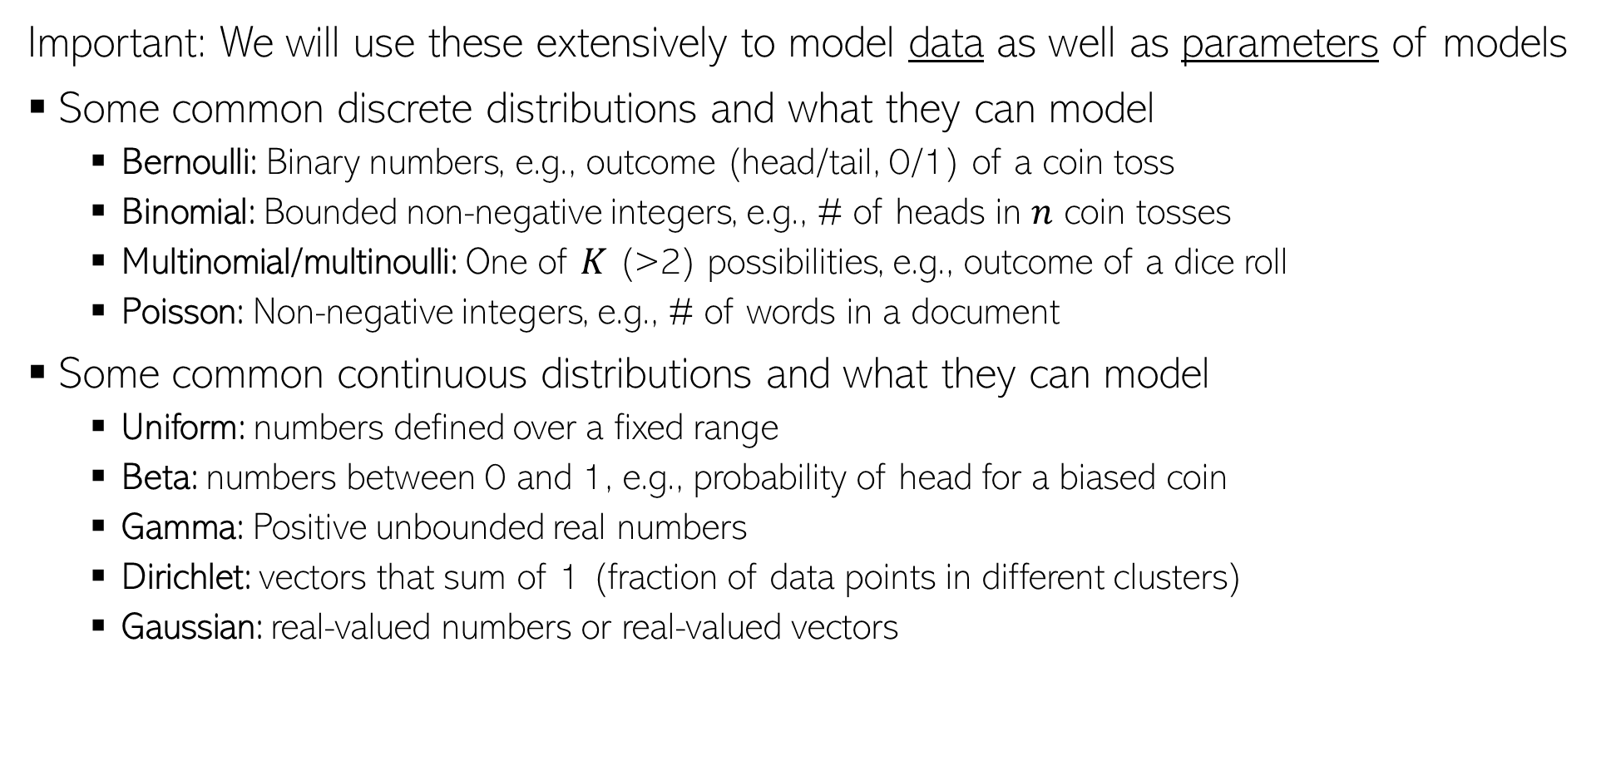
Common Probability Distributions
Important: We will use these extensively to model data as well as parameters of models
Some common discrete distributions and what they can model
Bernoulli: Binary numbers, e.g., outcome (head/tail, 0/1) of a coin toss
Binomial: Bounded non-negative integers, e.g., # of heads in $n$ coin tosses
Multinomial/multinoulli: One of $K$ (>2) possibilities, e.g., outcome of a dice roll
Poisson: Non-negative integers, e.g., # of words in a document
Some common continuous distributions and what they can model
Uniform: numbers defined over a fixed range
Beta: numbers between 0 and 1, e.g., probability of head for a biased coin
Gamma: Positive unbounded real numbers
Dirichlet: vectors that sum of 1 (fraction of data points in different clusters)
Gaussian: real-valued numbers or real-valued vectors

Slide 8
Coming up next
Probabilistic Modeling
Basics of parameter estimation for probabilistic models

